Slide 1
Mercury: Efficient On-Device Distributed DNN Training via Stochastic Importance Sampling
Xiao Zeng, Ming Yan, Mi Zhang
SenSys 21
Presented by Huai-an Su

Slide 2
Outline
Motivation
Mercury
Implementation Setup
Results
Conclusion

Slide 3
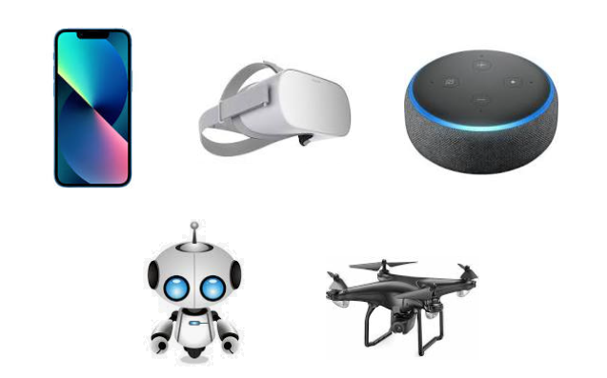
Motivation
Deep learning model training
Smart phones, AR/VR headsets, Smart speakers, Robotics, Drones

Slide 4
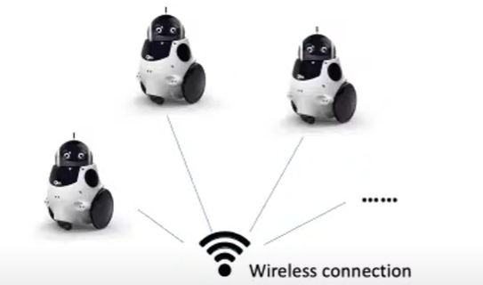
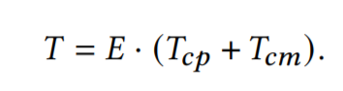
Motivation
Contribution: On-device distributed Training
Limitation: significant amount of training time
Limited bandwidth slows down communication

Slide 5
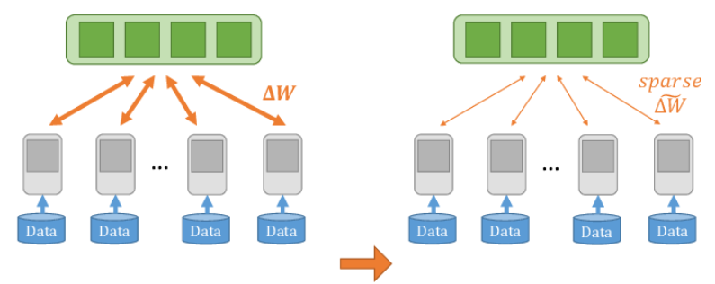
Motivation
Solution 1: gradient compression
Quantizing gradients (smaller number of bits)
Sparsification (selecting important gradients)
Sacrifices the accuracy of the trained model

Slide 6
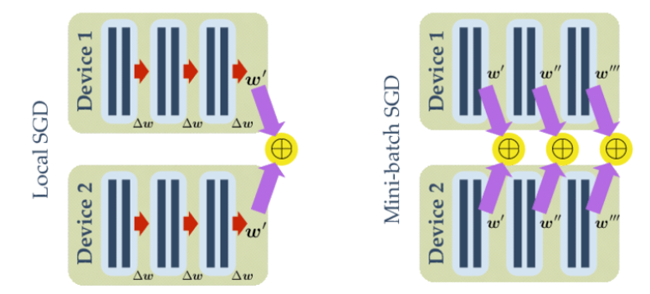
Motivation
Solution 2: Local SGD
Clients perform multiple local updates
May deviate from global optimal model

Slide 7
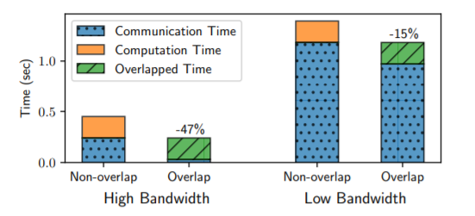
Motivation
Solution 3: Overlapping
Overlap communication with gradient computation
Can mask out the communication cost
On-device communication is way higher than gradient computation

Slide 8
Mercury
Improve training efficiency
Reduce the iterations for convergence
Key concept: importance sampling

Slide 9
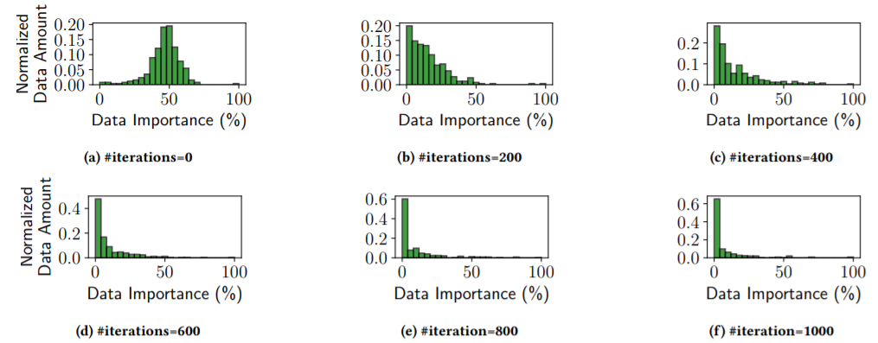
Mercury
Data importance distribution differs as the iteration goes up

Slide 10
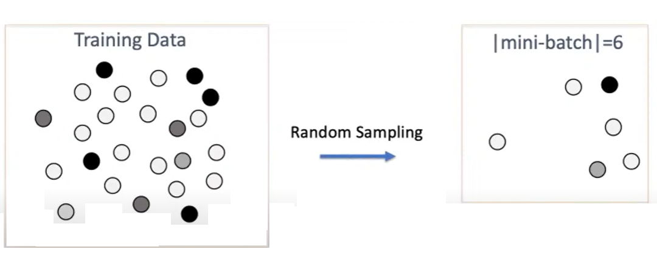
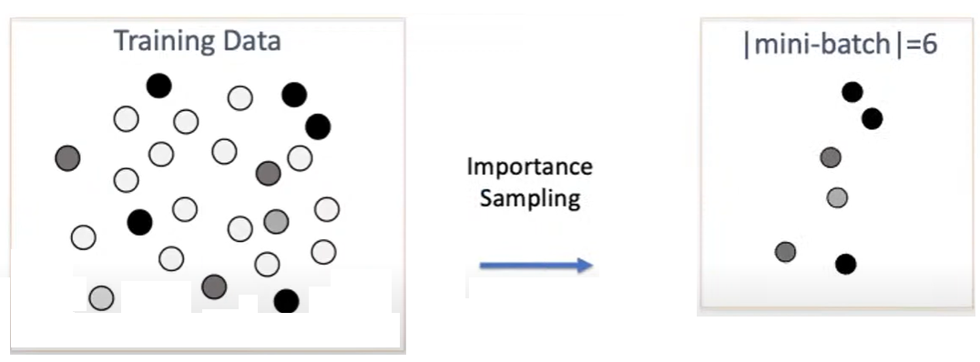
Mercury

Slide 11
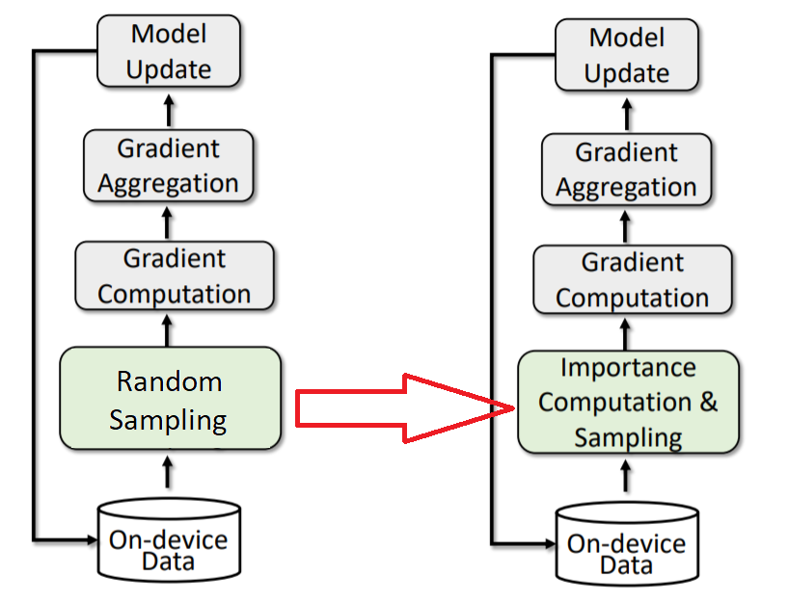
Mercury
Framework

Slide 12
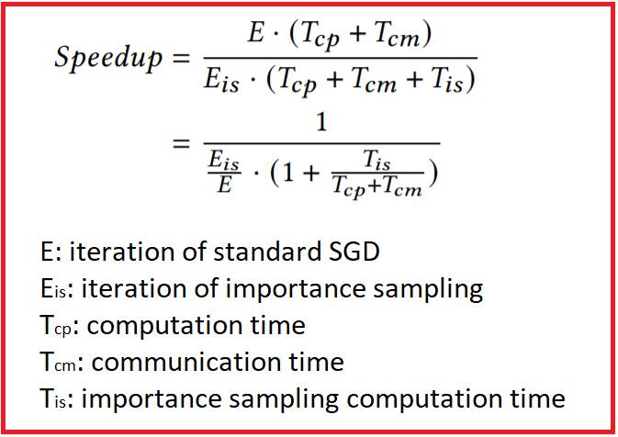
Mercury
Challenge 1: importance sampling incurs computation cost

Slide 13
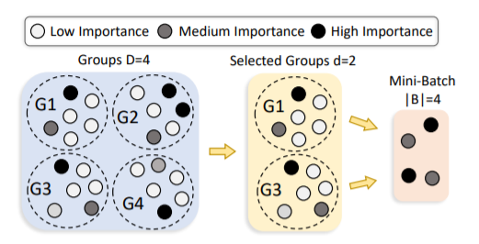
Mercury
Solution 1: Group-wise Importance Sampling
Divide training data into groups
Only update importance distribution for one group
Reuse cached distribution from other groups

Slide 14
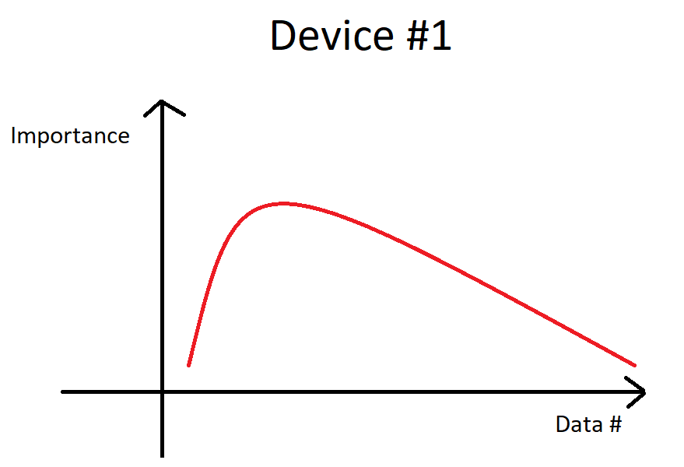
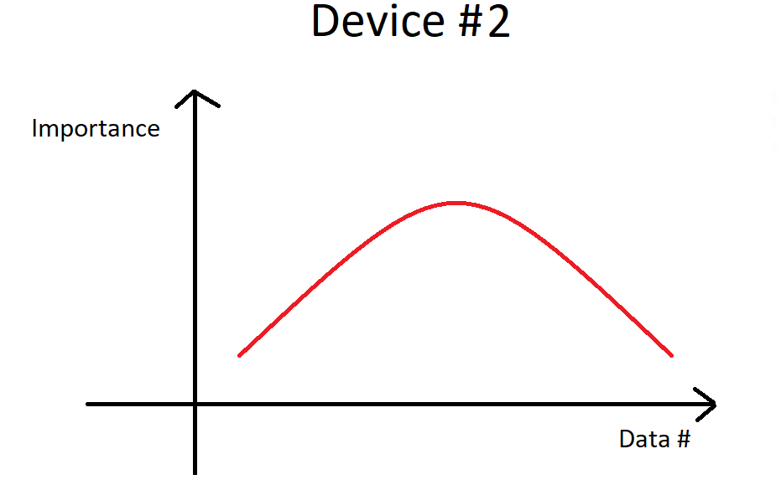
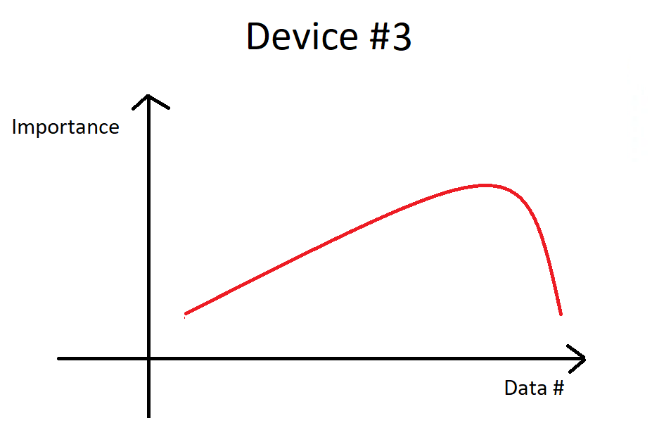
Mercury
Challenge 2: Data importance is imbalanced
A device may learn global trivial samples

Slide 15
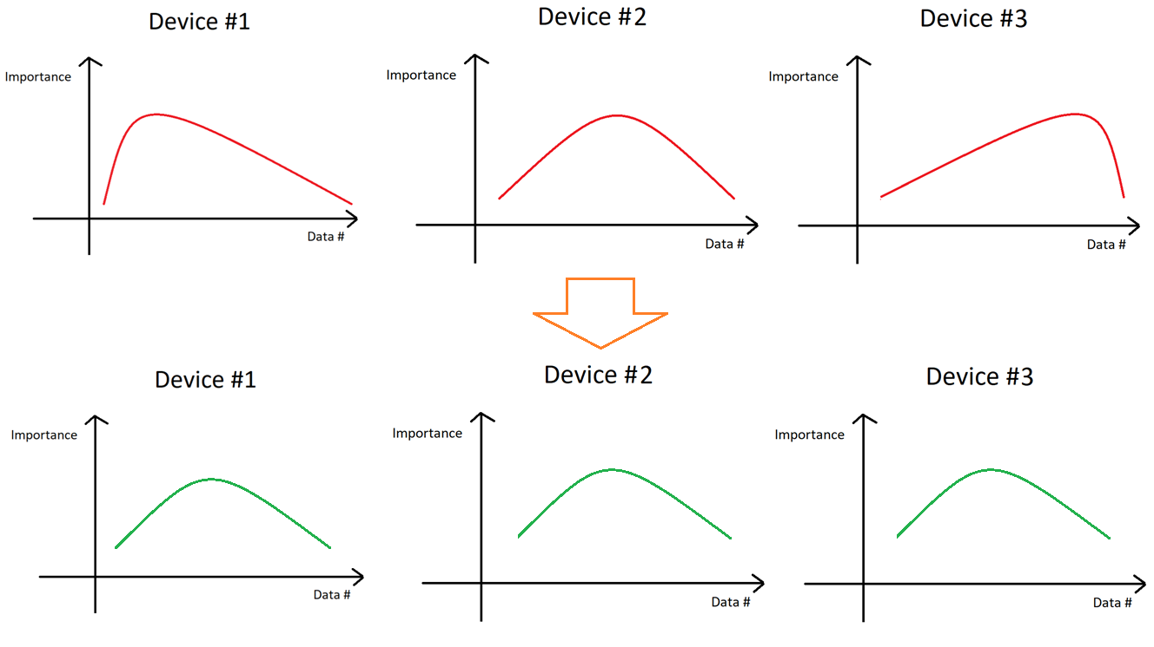
Mercury
Solution 2: Importance-aware Data Resharding
Redistribute samples among workers
Select non-trivial samples to shuffle

Slide 16
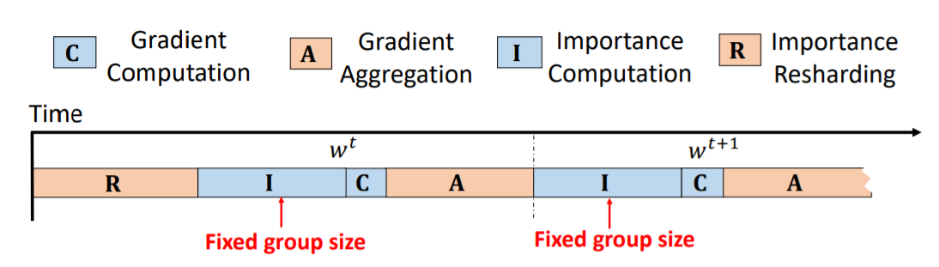
Mercury
Challenge 3: Sequential implementation is inefficient

Slide 17
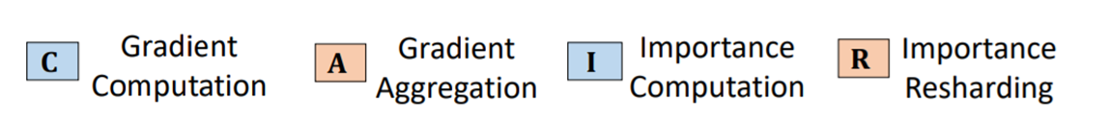
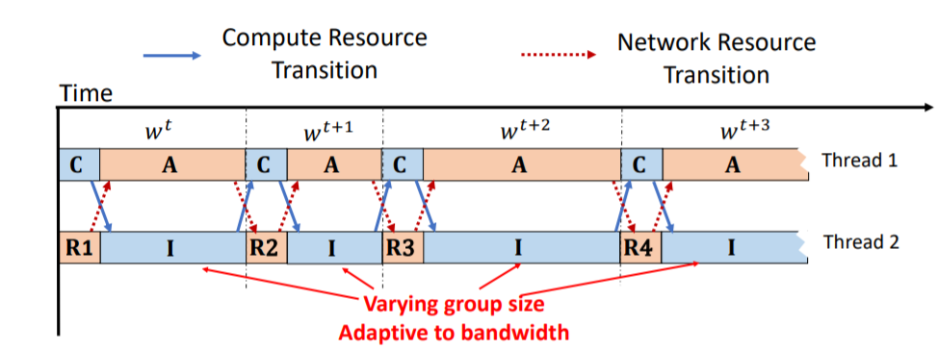
Mercury
Solution 3: Bandwidth-adaptive computation-communication (BACC) scheduler

Slide 18
Mercury
To fully overlap I with A: Adopt varying group sizes

Slide 19
Mercury
To fully overlap R with C: Resharding pauses when aggregation begins and resumes when it ends

Slide 20
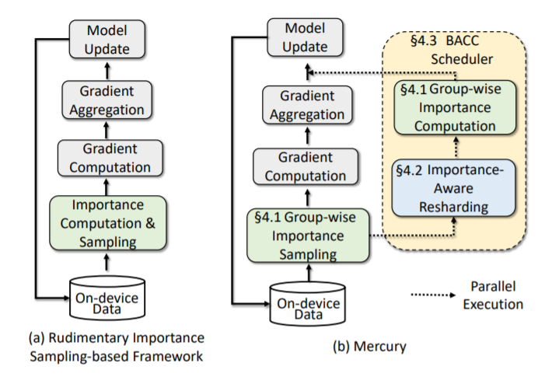
Mercury
Framework

Slide 21
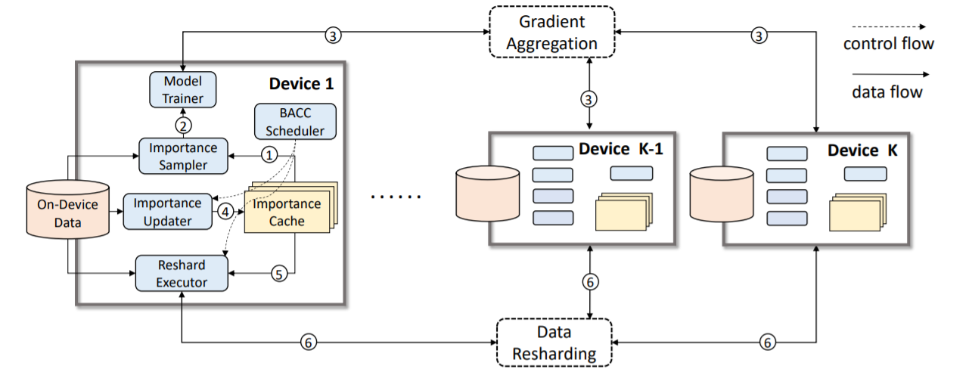
Mercury
System architecture
1) Construct mini-batch from on-device data in importance cache

Slide 22
Mercury
System architecture
2) Mini-batch is fed to model trainer to compute local gradient

Slide 23
Mercury
System architecture
3) Gradients aggregated, model updated

Slide 24
Mercury
System architecture
4) Re-compute the data importance and update the Importance Cache

Slide 25
Mercury
System architecture
5) Identify important data samples from Importance Cache

Slide 26
Mercury
System architecture
6) Communicate with other devices to perform importance-aware data resharding

Slide 27
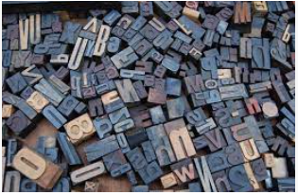
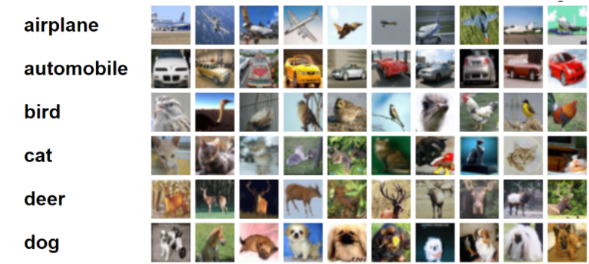

Implementation Setup
Applications & models
Image Classification (ResNet)
Speech Recognition (VGG)
Next Language Processing (LSTM)

Slide 28
Implementation Setup
Datasets:
Image Classification
Cifar10, Cifar100, SVHN, Aerial Image Dataset
Speech Recognition
Tensorflow Speech Command Dataset
Next Language Processing
AG News Corpus

Slide 29
Implementation Setup
Devices:
12 NVIDIA Jetson TX1
Wifi routers to connect all TX1
Baselines:
TicTac (overlapping communication & computation)
Adacomm (Local SGD)

Slide 30
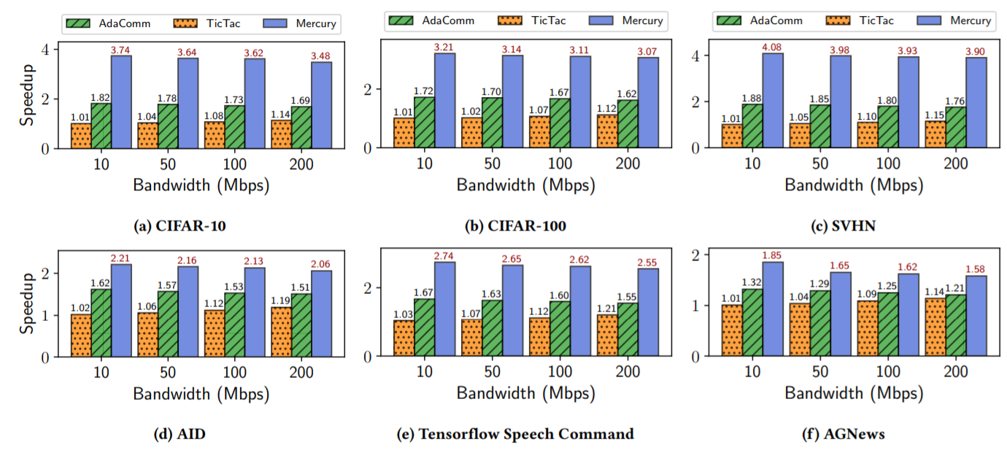
Results
End-to-end performance

Slide 31
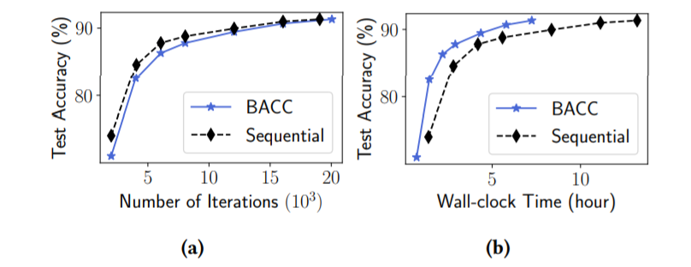
Results
Sequential implementation & BACC scheduler

Slide 32
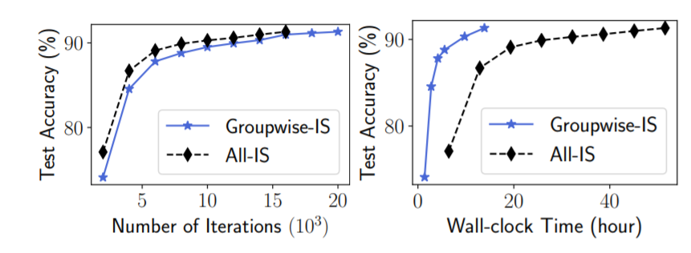
Results
Group importance & All-inclusive

Slide 33
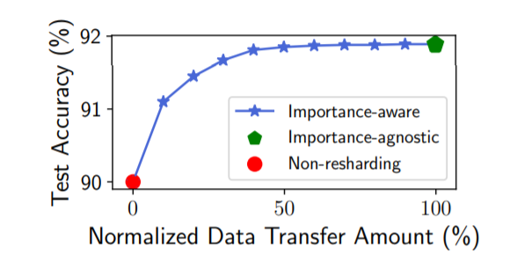
Results
Importance-Aware & Importance-Agnostic

Slide 34
Conclusion
Mercury enables efficient training
Mercury doesn’t damage accuracy too much
Mercury addresses challenges using
1) Group-wise importance sampling
2) Importance-aware resharding
3) BACC scheduler

